Slide 1
Evaluation First Testing
Robotic Arm - Semesterarbeit

Slide 2
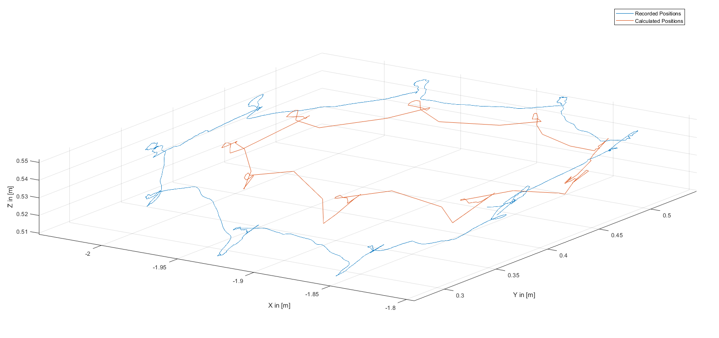
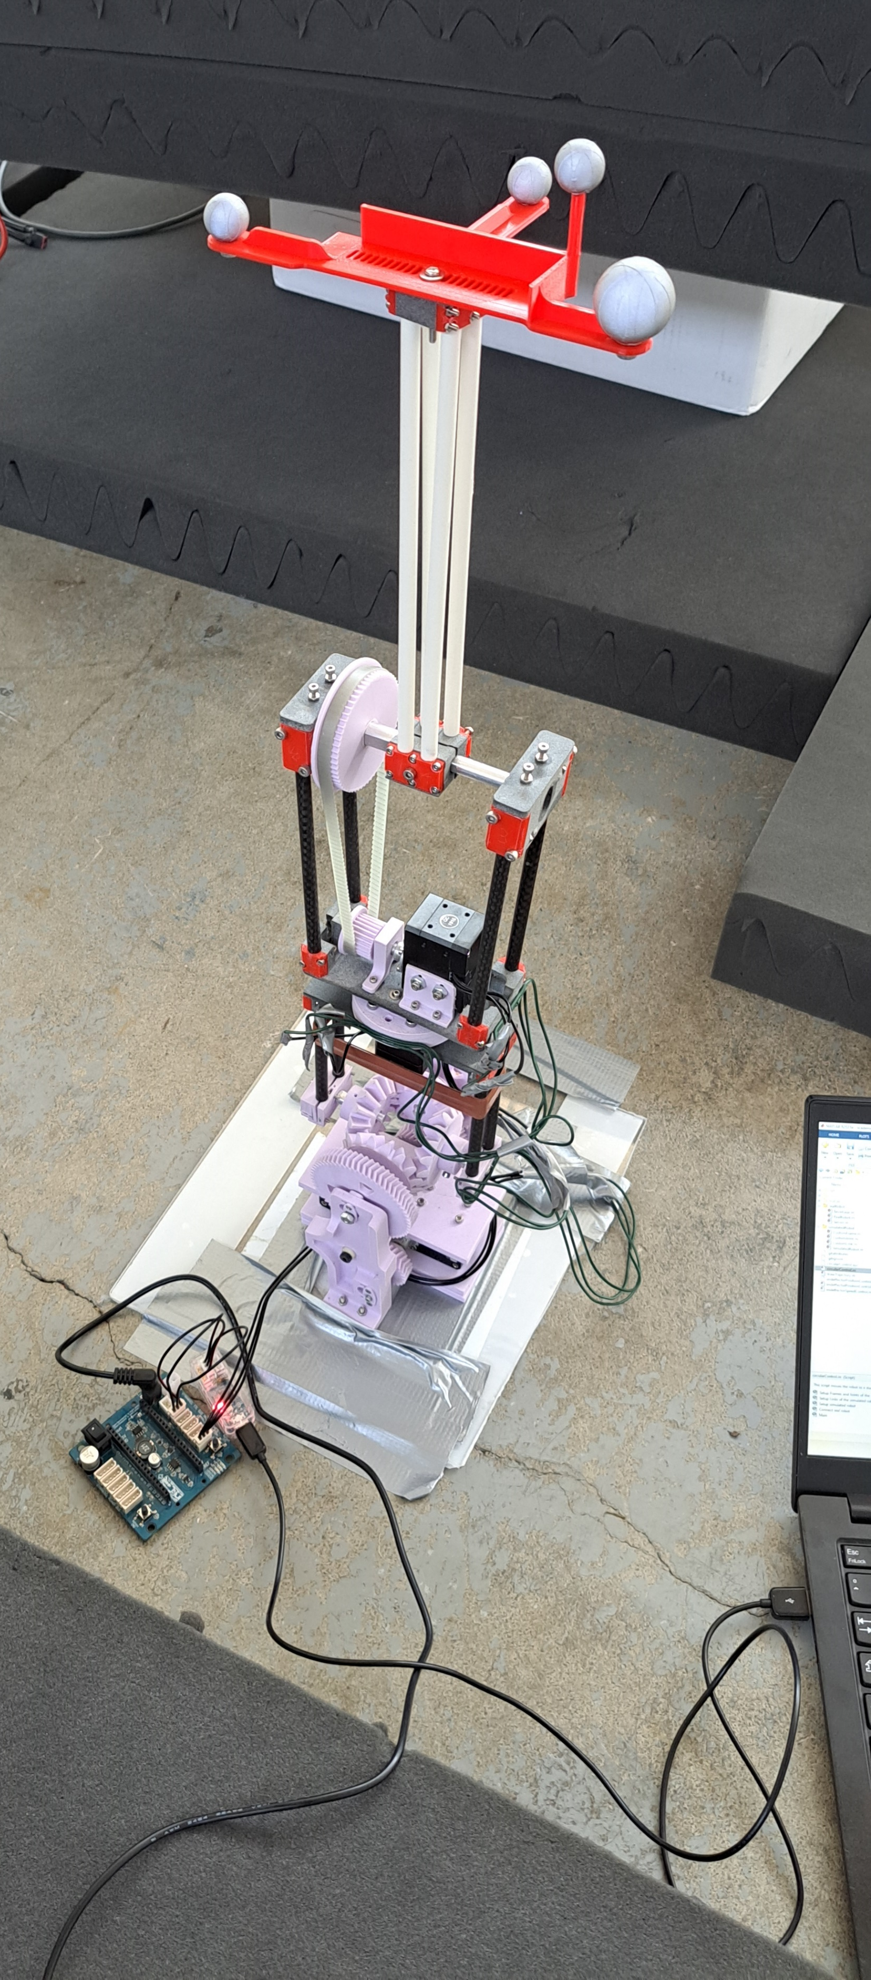
Task: Follow a circular trajectory (r = 0.1m)

Slide 3
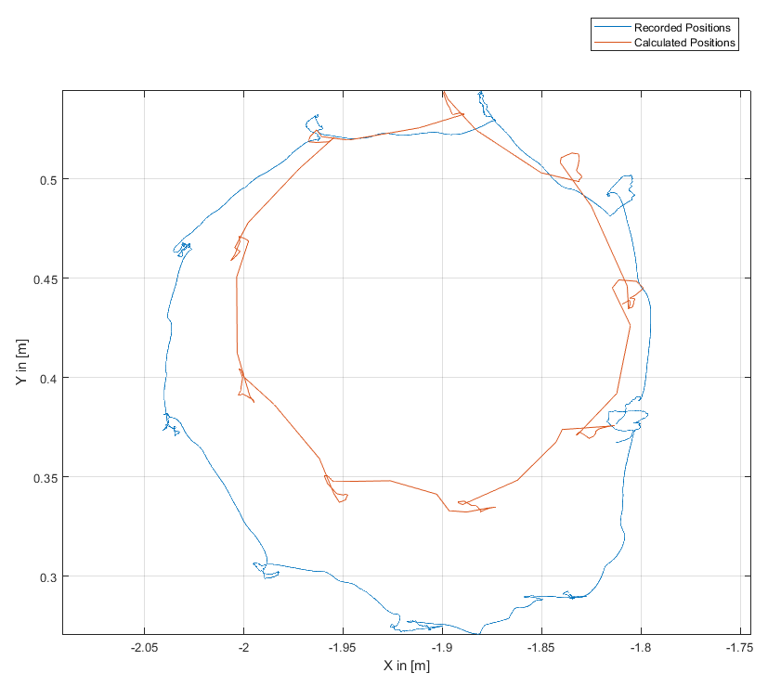
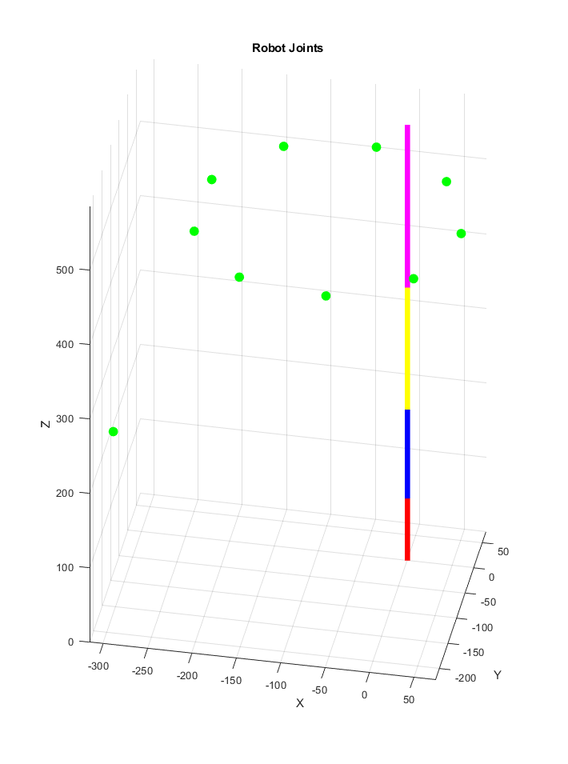
Recorded Positions (Camera) vs. Calculated Postions
The „Calculated Position“ of the Endeffector is calculated using the current Servo angles and the forward kinematic equations
The „Recorded Position“ of the Endeffector is measured via motion tracking cameras

Slide 4
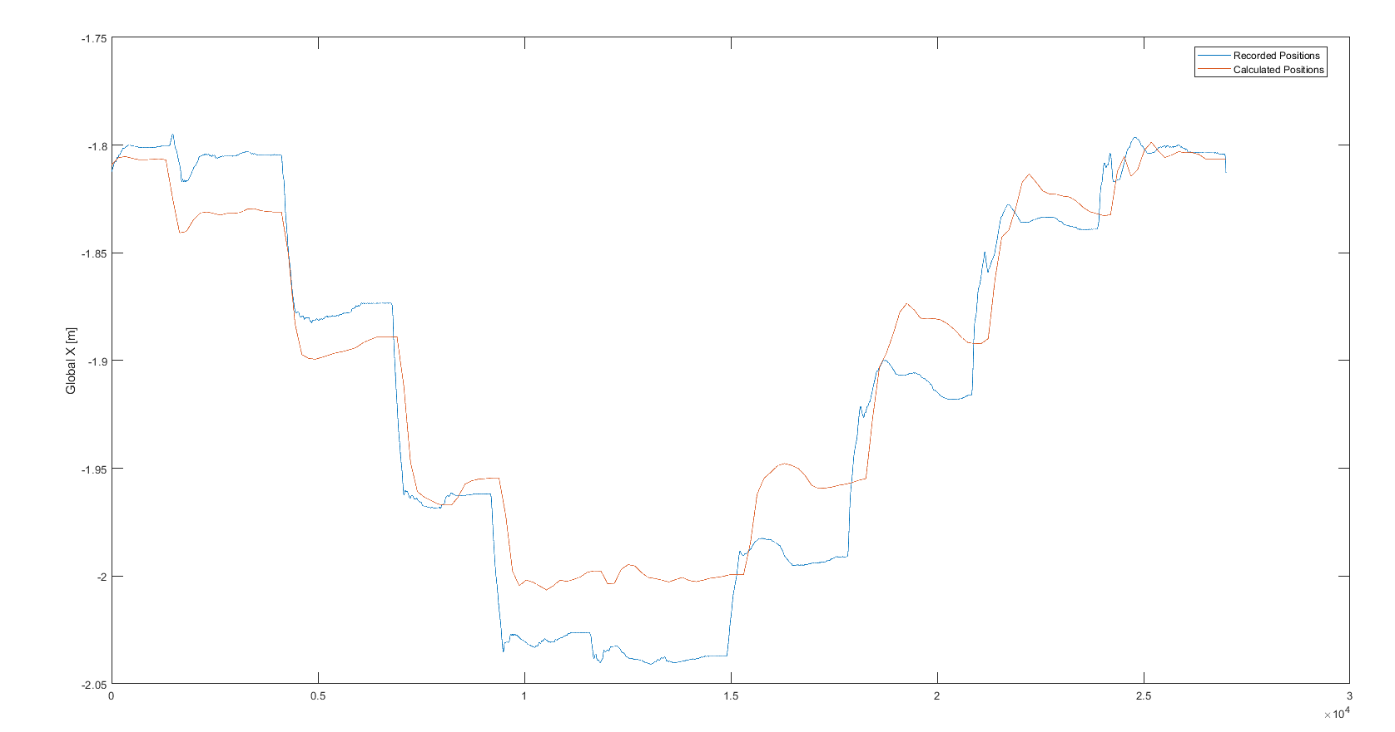
Comparison of Single Coordinate : X - Value

Slide 5
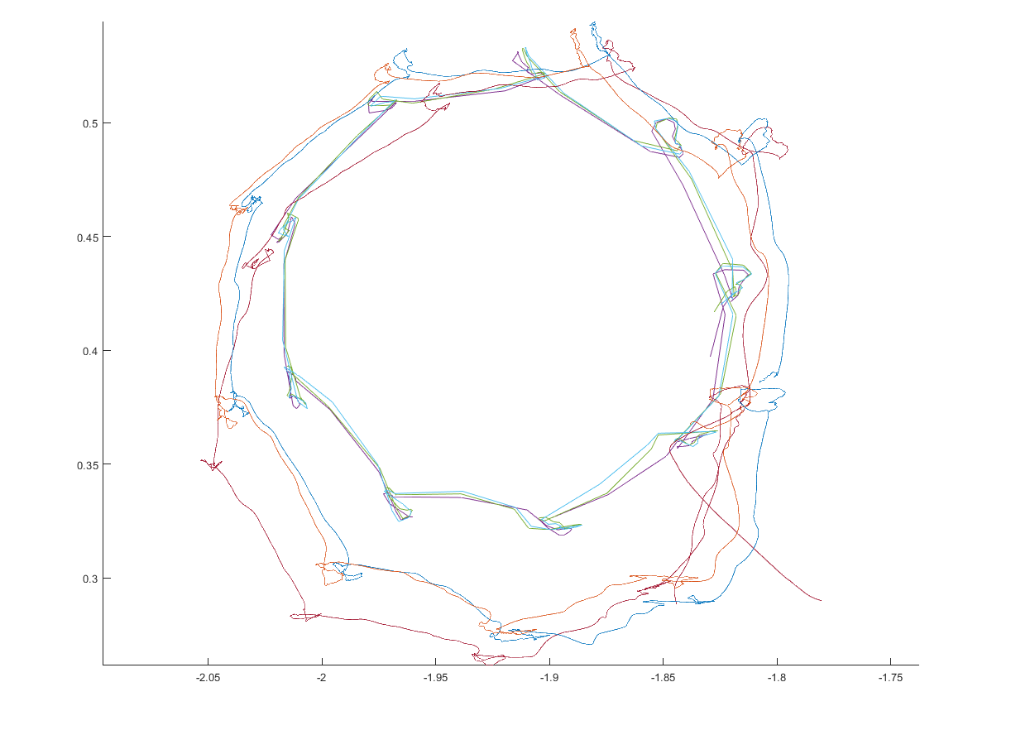
Comparison of multiple runs
3 Consecutive Runs

Slide 6
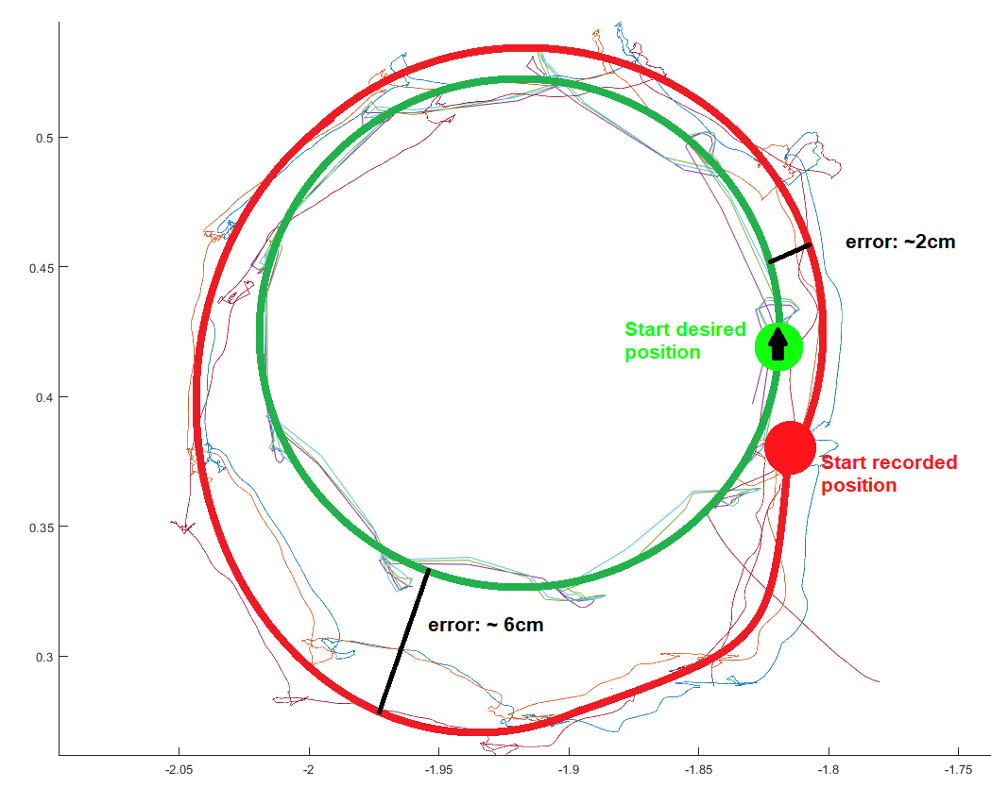
Evaluation of averaged runs
Desired position =~ Calculated position
Position error biggest at the bottom of circle ~6cm (maybe due to max tilt or errors adding up)
Position has a constant offset ~2cm (maybe due to placement of motion tracker)

Slide 7
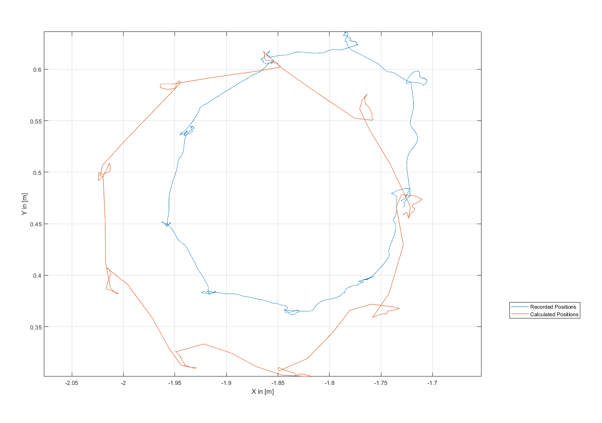
Bigger Radius : 0.15 m
Robot does not reach the big radius
Accuracy even worse for large movements

